Slide 1
M&T Bank Commercial Webinar Series
M&T Commercial Card Alerts
Presented By: Lisa Romanini, Commercial Card Product Management
November, 2018
©2018 M&T Bank. Member FDIC.

Slide 2
Agenda
M&T Bank Commercial Webinar Series
Commercial Card Alerts
What is it?
Which Alerts are Available?
How and Where do I Enroll?
Demo

Slide 3
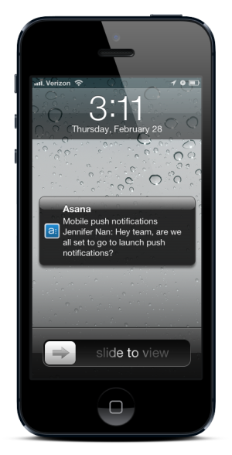
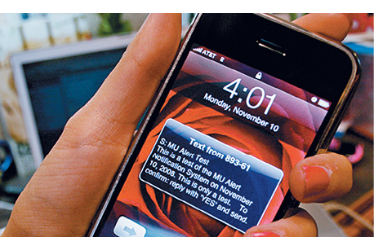
M&T COMMERCIAL CARD ALERTS
©2018 M&T Bank. Member FDIC.

Slide 4
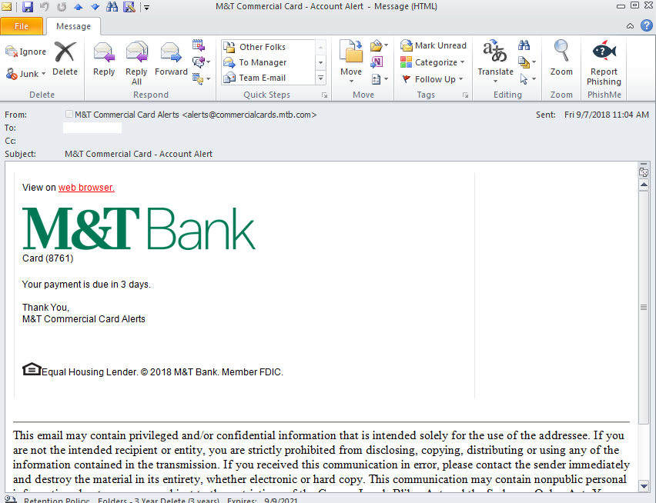
What are Commercial Card Alerts?
Commercial Card Alerts
Provide automated notifications based on events or transactions that occur within your program.
Empower organizations, program administrators, and cardholders to make important decisions using up-to-date information.
Provide early warnings on suspicious activity

Slide 5
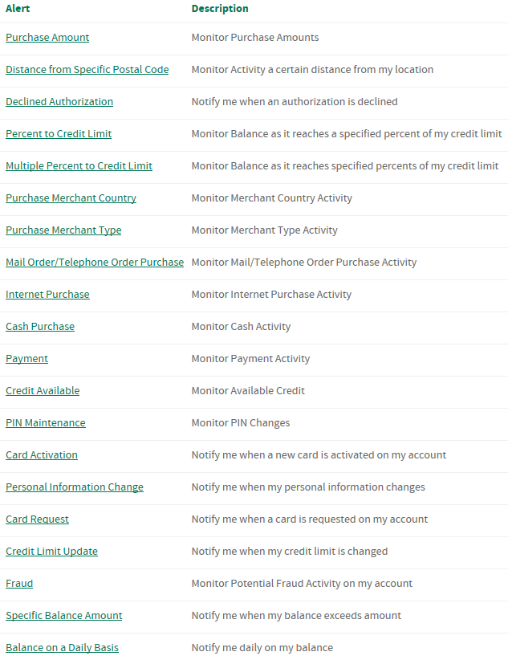
Key Features
Commercial Card Alerts
Enroll & Self Service in CentreSuite
Manage Contact Info
Two Main Types of Alerts:
Financial Alerts
Fraud Alerts
One-Way, Two Way, & Inquiries
Text, E-mail, & Voice (fraud alerts only)
Easier, direct URL option for CentreSuite in alerts:
Centresuite.mtb.com
*final list of alerts released may vary slightly

Slide 6
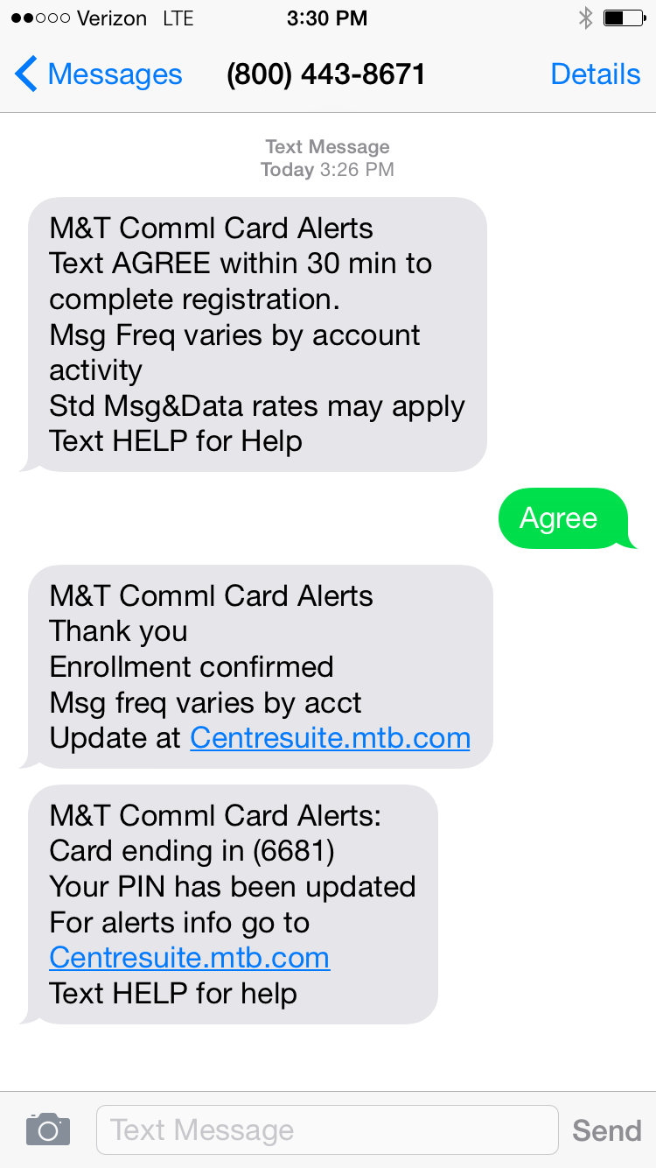
Alert Options for Users
Commercial Card Alerts
Individual Cardholders can set alerts for themselves ONLY
Org Admin Users can:
Set up to receive alerts themselves for cardholder activity
On Single Cards
On Multiple Cards
On the Whole Company
Set up alerts to be received by their cardholders for cardholder activity (ie: on behalf of cardholder)
Set up to receive alerts themselves for activity on the Corporate account number
Tip: Be Careful! Alerts work!
As an Org Admin, don’t subscribe to get every alert on every card in your program. It won’t be efficient and will overload you quickly.

Slide 7
Commercial Card Alerts - Resources
Commercial Card Alerts
Alerts Web Page - www.mtb.com/commercialalerts
User Guide
FAQ
CentreSuite User Guide Page – Access from CentreSuite Bank Messages (under CentreSuite User Guides link)
As of October 15th, 2018, Commercial Card alerts are live.
If a CentreSuite user (org admin or cardholder) wishes to use alerts, they may go into CentreSuite to enroll in alerts, set their contact info, and choose which alerts they want to receive.

Slide 8
Commercial Card Alerts and Digital Wallet Support
Appendix
©2018 M&T Bank. Member FDIC.

Slide 9
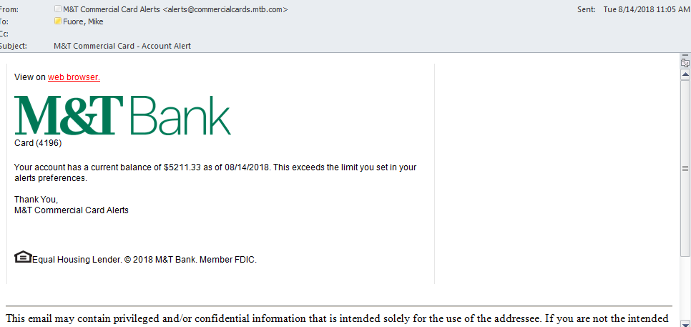
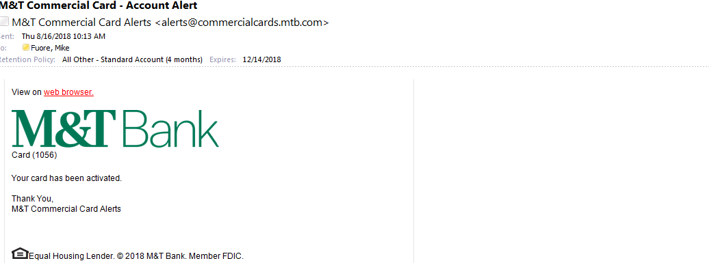
Two E-mail Alert Samples
Commercial Card Alerts

Slide 10
CentreSuite Enrollment
Commercial Card Alerts
Cardholder View

Slide 11
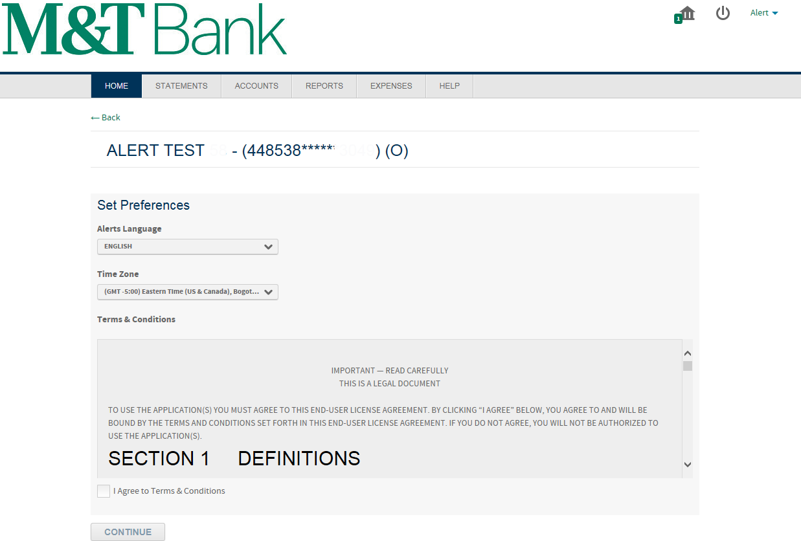
CentreSuite Enrollment
Commercial Card Alerts

Slide 12
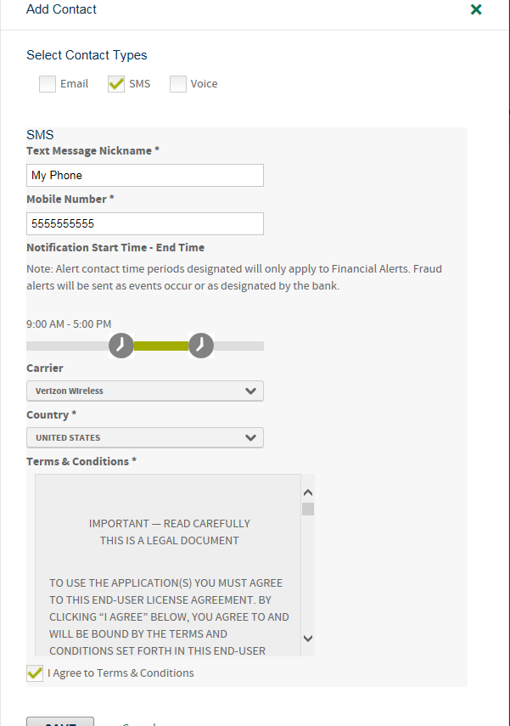
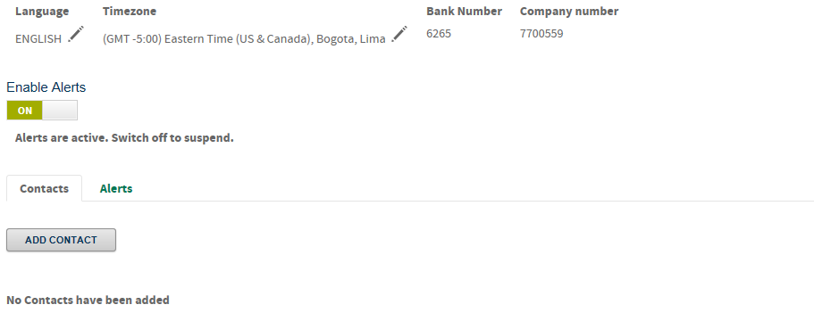
CentreSuite Enrollment
Commercial Card Alerts

Slide 13
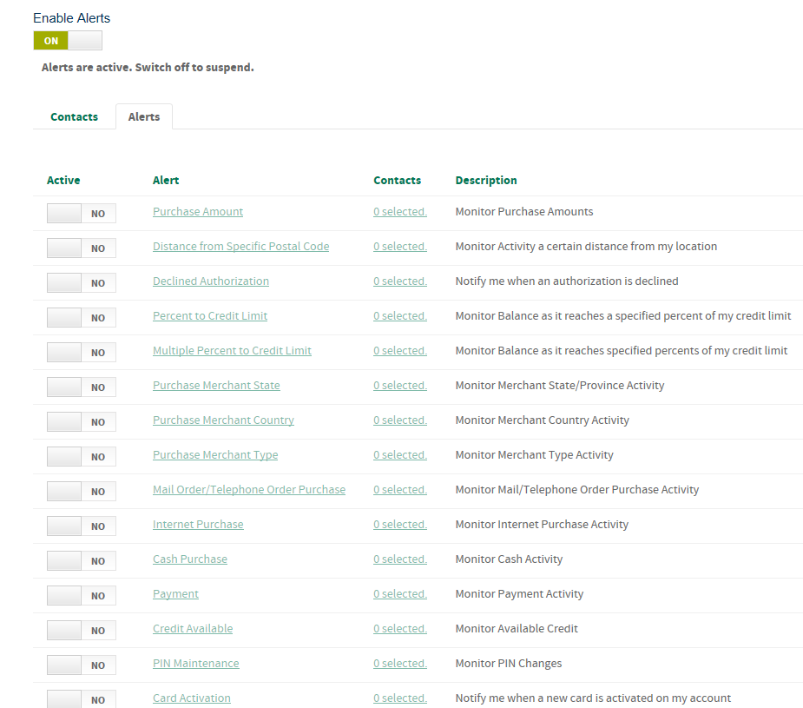
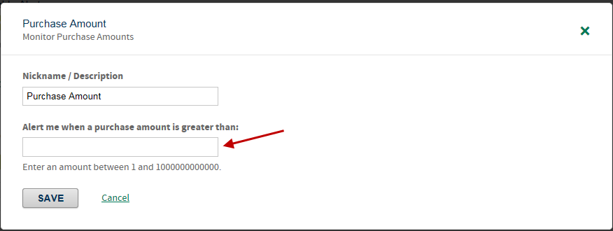
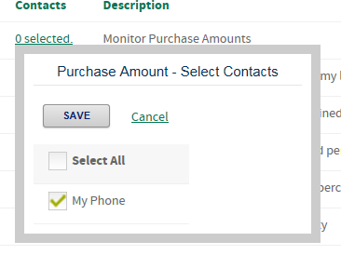
CentreSuite Enrollment
Commercial Card Alerts

